Slide 1


Amrita School Of Engineering B. Tech CSE-AI
19AIE104
INTRODUCTION TO ELECTRICAL ENGINEERING

Slide 2
VOLTAGE COMPARATOR (UNDER THE GUIDANCE OF DR.V. Sowmya)
Done by :
DIVITH PHOGAT – AIEA.14193
GARAPATI VENKATA KRISHNA – AIEB.24735
JAYANTH M – AIEB.10655
KARNATI SAI PRASHANTH – AIEB.25264
MANISH RAMA GOPAL NADELLA - AIEB.12015

Slide 3
OBJECTIVE:-
To learn about operational amplifier or op amp , that is designed with certain characteristics (high input resistance, low output resistance, and a large differential gain) that make it a nearly ideal amplifier and useful building-block in many circuit applications. OP AMP is almost like an ideal amplifier.
MATERIALS REQUIRED:-
simulation platform [ Falstad/Matlab]

Slide 4
DESCRIPTION OF COMPONENTS:
Falstad:
This is an electronic circuit simulator. When the applet starts up you will see an animated schematic of a simple LRC circuit. The green color indicates positive voltage. The gray color indicates ground. A red color indicates negative voltage. The moving yellow dots indicate current.
To turn a switch on or off, just click on it. If you move the mouse over any component of the circuit, you will see a short description of that component and its current state in the lower right corner of the window.
MATLAB
MATLAB® combines a desktop environment tuned for iterative analysis and design processes with a programming language that expresses matrix and array mathematics directly. It includes the Live Editor for creating scripts that combine code, output, and formatted text in an executable notebook.

Slide 5
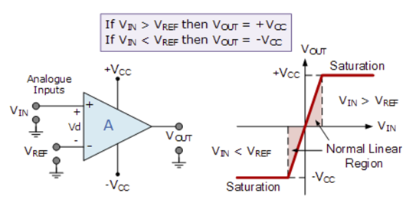
CIRCUIT DIAGRAM:-
For using op amp as comparators:

Slide 6
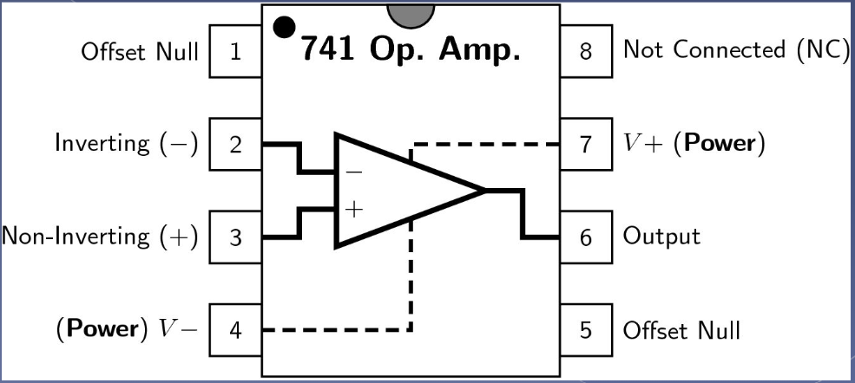
BASIC CONCEPT:-
Op amp :
An operational amplifier is an integrated circuit that can amplify weak electric signals. An operational amplifier has two input pins and one output pin. Its basic role is to amplify and output the voltage difference between the two input pins.
Op amp as a comparator :
The Op-amp comparator compares one analogue voltage level with another analogue voltage level, or some preset reference voltage, V_{REF} and produces an output signal based on this voltage comparison. In other words, the op-amp voltage comparator compares the magnitudes of two voltage inputs and determines which is the largest of the two.
Voltage comparators either use positive feedback or no feedback at all (open-loop mode) to switch its output between two saturated states (+Vcc ,-Vcc), because in the open-loop mode the amplifiers voltage gain is basically equal to A_{VO}.
Then due to this high open loop gain, the output from the comparator swings either fully to its positive supply rail, +Vcc or fully to its negative supply rail, -Vcc on the application of varying input signal

Slide 7
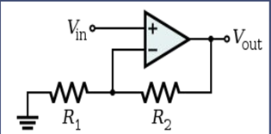
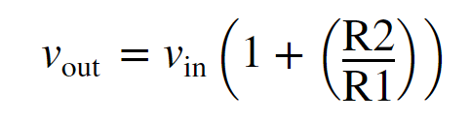
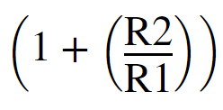
Non inverting amplifier/ Positive Voltage Comparator:-
It is an op-amp circuit which gives an amplified signal as output. In this electronic circuit design the signal is applied to the non-inverting input of the op-amp.
In this way the signal at the output is not inverted when compared to the input. The output signal is in phase with the applied input signal.
However the feedback is taken from the output of the op-amp via a resistor to the inverting input [uses a negative feedback connection] of the operational amplifier where another resistor is taken to ground.
it is the value of these two resistors that govern the gain of the operational amplifier circuit as they determine the level of feedback.
Closed loop op amp
;Here amplification factor is …..................

Slide 8
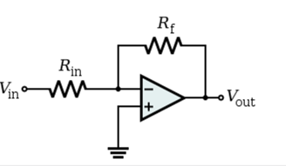


inverting amplifier/ Negative Voltage Comparator:-
An inverting amplifier (also known as an inverting operational amplifier or an inverting op-amp) is a type of operational amplifier circuit which produces an output which is out of phase with respect to its input by 180o.
This means that if the input pulse is positive, then the output pulse will be negative and vice versa
Closed loop op amp
Here we apply the input signal to the inverting terminal of the op-amp via the resistor Ri. We connect the non-inverting terminal to ground. Further, we provide the feedback necessary to stabilize the circuit, and hence to control the output, through a feedback resistor Rf.
Where Amplification factor =
check the negative sign in amplification factor it is because the output is inverted therefore a notation of negative sign is given

Slide 9
Op-amp comparator
It compares one analogue voltage level with another analogue voltage level, or some preset reference voltage, V_{REF} and produces an output signal based on this voltage comparison. In other words, the op-amp voltage comparator compares the magnitudes of two voltage inputs and determines which is the largest of the two.
operational amplifier can be used with negative feedback to control the magnitude of its output signal in the linear region performing a variety of different functions.
Voltage comparators on the other hand, either use positive feedback or no feedback at all (open-loop mode) to switch its output between two saturated states, because in the open-loop mode the amplifiers voltage gain is basically equal to A_{VO}.
It compares the two input voltages and output ranges from the comparator swings either fully to its positive supply rail, +Vcc or fully to its negative supply rail -Vcc

Slide 10
Negative Feedback :
Positive Feedback
If we connect the output of an op-amp to its inverting input and apply a voltage signal to the noninverting input, we find that the output voltage of the op-amp closely follows that input voltage
The circuit will quickly reach a point of stability (known as equilibrium in physics), where the output voltage is just the right amount to maintain the right amount of differential.
Taking the op-amp’s output voltage and coupling it to the inverting input is a technique known as negative feedback, and it is the key to having a self-stabilizing system
This stability gives the op-amp the capacity to work in its linear (active) mode, as opposed to merely being saturated fully “on” or “off” as it was when used as a comparator
positive feedback the output voltage is somehow routed back to the noninverting (+) input. The inverting input remains disconnected from the feedback loop, and is free to receive an external voltage
With the inverting input grounded (maintained at zero volts), the output voltage will be dictated by the magnitude and polarity of the voltage at the noninverting input.
If that voltage happens to be positive, the op-amp will drive its output positive as well, feeding that positive voltage back to the noninverting input, which will result in full positive output saturation.
On the other hand, if the voltage on the noninverting input happens to start out negative, the op-amp’s output will drive in the negative direction, feeding back to the noninverting input and resulting in full negative saturation.
An op-amp with positive feedback tends to stay in whatever output state its already in. It “latches” between one of two states, saturated positive or saturated negative. Technically, this is known as hysteresis.

Slide 11
PROCEDURE:-
1.) Go to falstad.com
2.)start with giving the input source (battery)
3.) click w to select connecting wires and click r to click resistance
4.)add connecting wires and resistance as shown in the diagram
5.)under draw tab click input sources and use ac input for a sin graph
5.)Under draw click op amp to use op amp
6.)connect the wire and resistance to the op amp
7.)click run/simulate to see the graph
8.)to give triangular wave use input as a triangular wave

Slide 12
Stimulation in Matlab : (sin Wave )
open MATLAB and type Simulink in the command window and click Simulink library to search for the components .
search for an AC voltage source , and 2 – resistors (in which one of it acts as a feedback resistor) ,ground and an op – amp . And place them on the blank space .
We need 2 - voltage sensors , 2 - PS – Simulink converter , a solver configuration and a scope .
Now arrange them respectively and connect all the components accordingly .
For the inverting comparator ,we have taken the frequency of the AC Voltage source 1000 hz ., the value of R2 is taken as 50 and the value of R1 is taken as 10. .
For the Non-inverting comparator , we have taken the frequency of the AC voltage source as 1000 hz , the value of R2 is taken as 20 and the value of R1 is taken as 10.

Slide 13
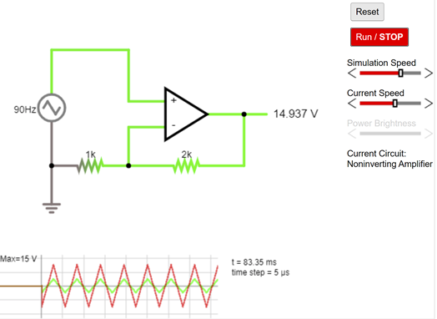
RESULT:-
A) triangle wave
Non inverting Opamp

Slide 14
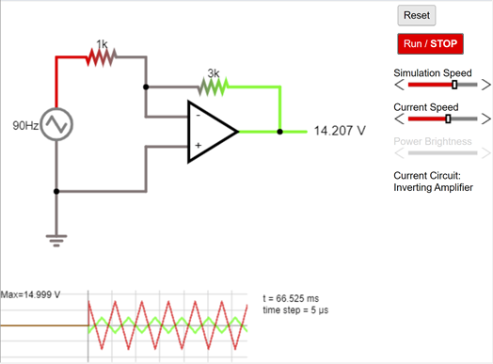
Inverting op amp:

Slide 15
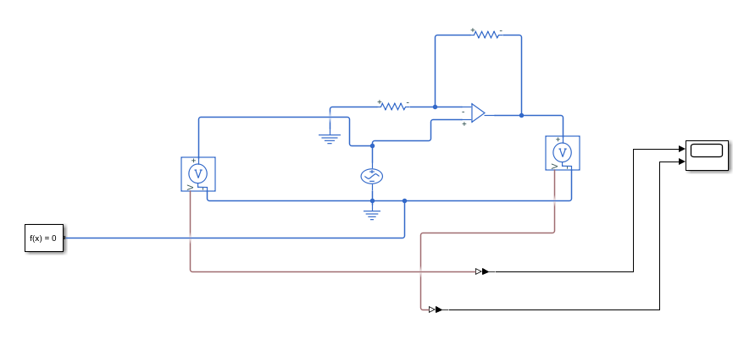
B) Sine wave:
Non Inverting Op Amp:

Slide 16
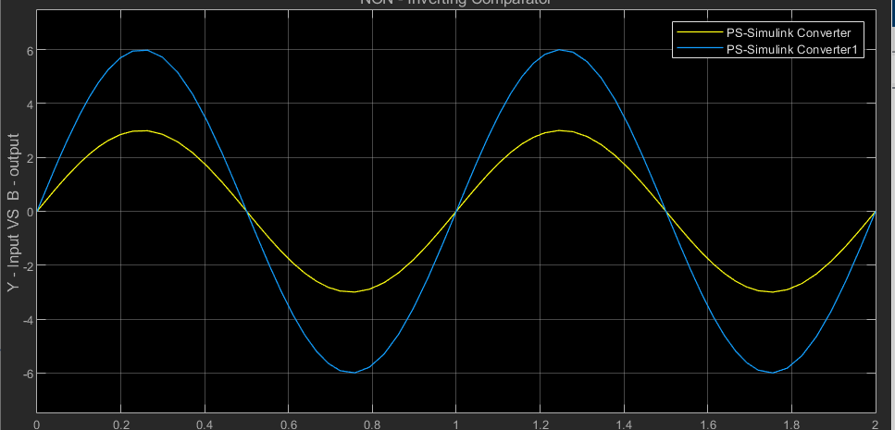

Slide 17
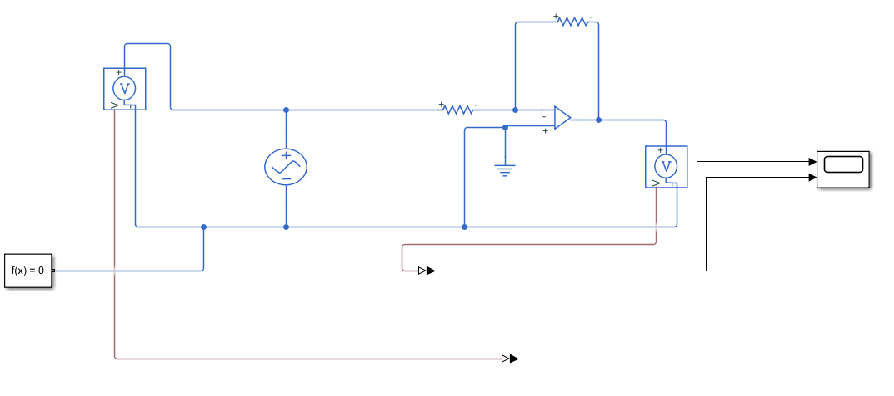
Inverting op Amp :

Slide 18
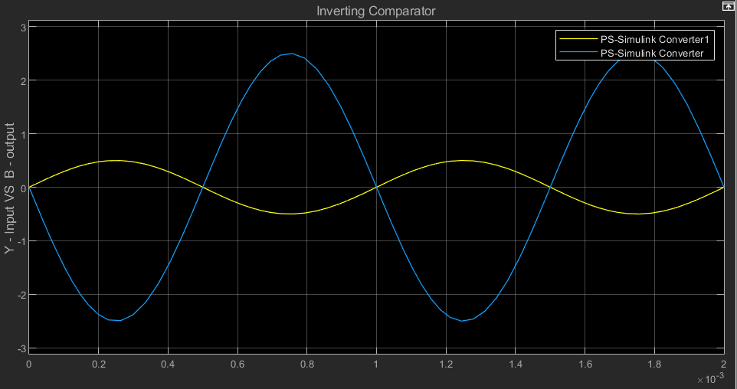

Slide 19
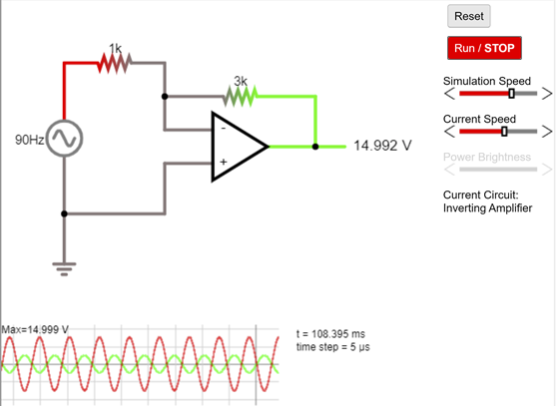
Falstad
Inverting Opamp

Slide 20
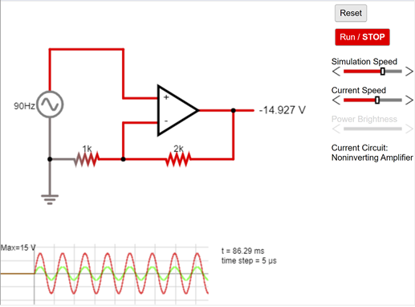
Non Inverting OpAmp

Slide 21
INFERENCE:-
When input voltage is greater than reference voltage the output goes to + v saturation.
When input voltage is less than reference voltage the output goes to -v saturation

